Slide 1
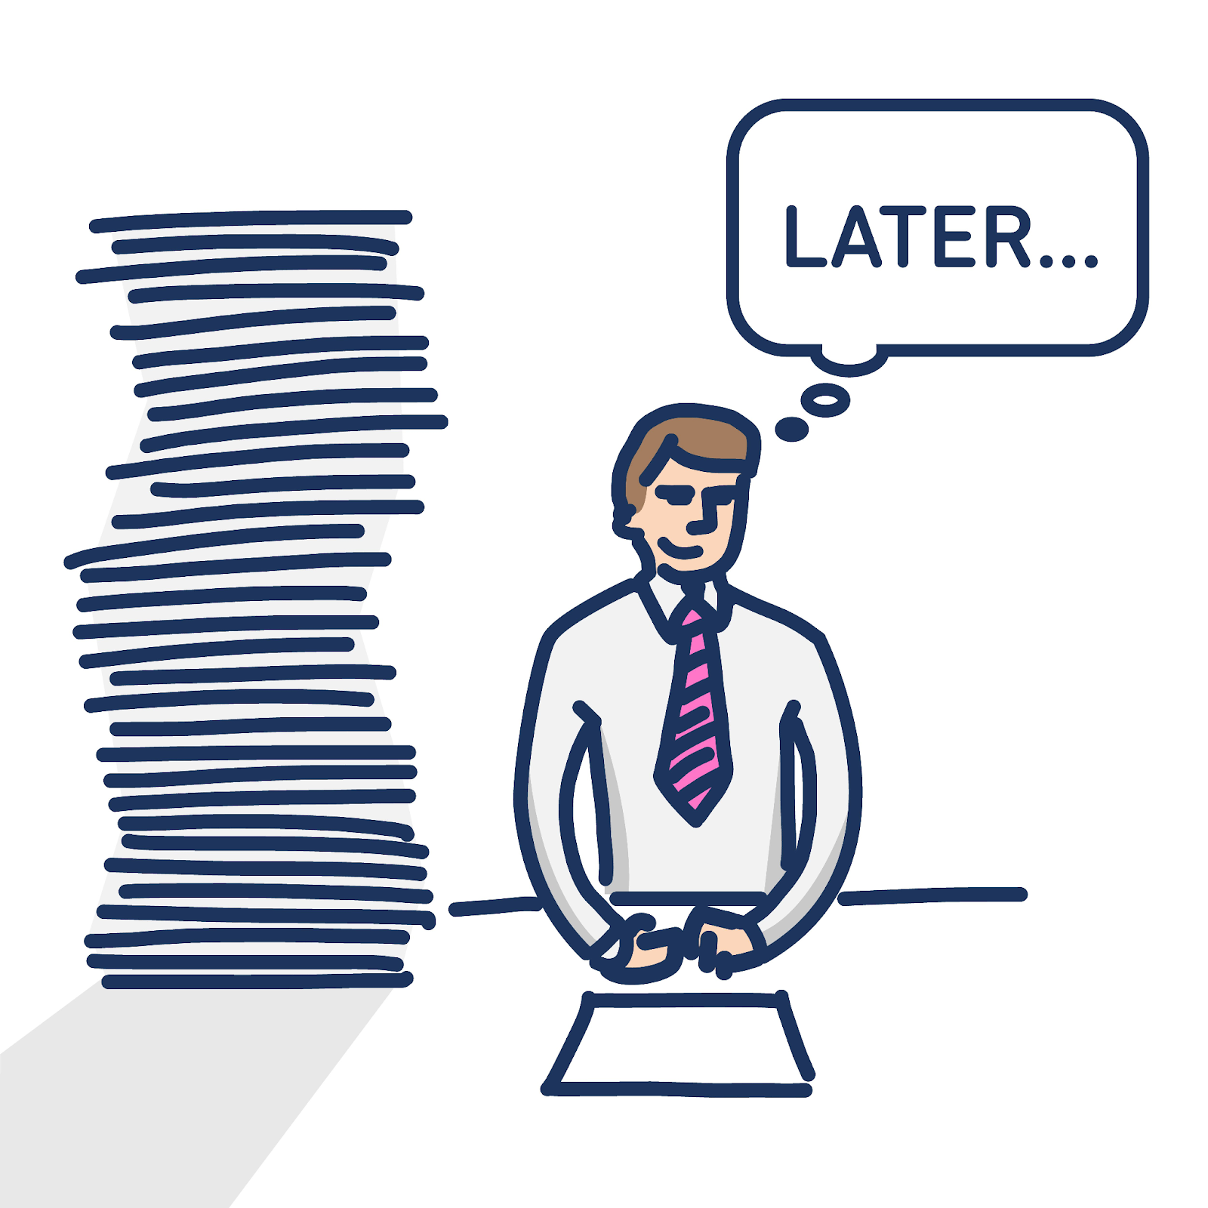
FACTORS INFLUENCING PROCRASTINATION IN OUR DAILY LIFE
Under the Guidance of Professor Bhuvaneswari M
Team Leader : Ansh G V

Slide 2

TEAM MEMBERS
Ansh G V - 19BME0274
Paritosh Kumar Patro - 19BME0387
Ashish Anand - 20BCE0369
Mothishwaran C - 19MID0017
Sabarinathan R V - 19MID0057
Tharun S - 19MID0031
Prashanth S - 19MID0020
Udhaya Priya S - 19MID0058
Bazaru Syam Sai Abhilash - 19BME0687

Slide 3

OBJECTIVE 1
To investigate if watching/reading before bedtime makes us procrastinate in our sleep ?
NULL HYPOTHESIS : Watching/reading before bedtime makes us procrastinate in our sleep.
DEPENDENT VARIABLE : Sleep
INDEPENDENT VARIABLE : watching movies, reading books.

Slide 4

OBJECTIVE 2
To investigate whether the type of people around us make us procrastinate in our daily work/activities ?
NULL HYPOTHESIS : The type of people around us make us procrastinate in our daily work/activities.
DEPENDENT VARIABLE : Daily work/activities.
INDEPENDENT VARIABLE : type of people around us.

Slide 5

OBJECTIVE 3
To investigate if a break in our plan schedule make us procrastinate in our work/activities ?
NULL HYPOTHESIS : A break in our plan schedule makes us procrastinate in our work/activities.
DEPENDENT VARIABLE : Daily work/activities.
INDEPENDENT VARIABLE : Planned schedule.

Slide 6
LITERATURE REVIEW
In this research named ,the study was about two types of procrastination.
Bed-time procrastination
While-in bed procrastination.
The result we got was that these two procrastinations aren't closely related so while studying sleep procrastination we must study them separately
- An Exploratory Study on Sleep Procrastination:
Bedtime vs. While-in-Bed Procrastination.
August 2020

Slide 7
LITERATURE REVIEW
Bedtime procrastination is negatively related to hours of sleep and positively related to indicators of insufficient sleep in the group of adolescents.
Bedtime procrastination was dominant in the sample, and its negatively associated with amount of sleep hours but positively related to sleep deprivation.
The Role of Bedtime Procrastination,
Chronotype and Autonomous vs. Controlled Motivational Regulations.
Romana Kadzikowska-Wrzosek, March 2018

Slide 8
LITERATURE REVIEW
Students need to avoid the procrastination and concentrate on their studies
Teachers and parents need to encourage the students on reading culture
Teachers who serve as model need to tell the students the implication of procrastination, so that they too will understand the negative impact of procrastination.
- adeniyi adewale Ojo, January 2019

Slide 9
RESEARCH GAP
In our work we are investigating all the environmental factors not just cell phones but also books, people and planned activities that might contribute to procrastination in our daily life.

Slide 10
METHEDOLOGY
We are planning to conduct a survey of at least 100 people using Google forms to validate the hypothesis that were decided based on the objectives.
We, as of now decided to use the valid statistical testing techniques for examining the survey result.
The specific statistical testing method will depend upon the type of Data collected from the survey.

Slide 11
QUESTIONNAIRES-1
QUESTIONS | RATING (1-5)
I often watch movies night
I go to bed early if I must get up early in the morning
If it is time to turn off the lights at night, I overthink what I read/watch before sleeping
I have a regular bedtime which I keep to
I easily stop with my activities when it is time to go to bed

Slide 12
QUESTIONNAIRES-2
QUESTIONS | RATING (1-5)
I get inspired by my friend’s circle work punctuality
I postpone my work due to sudden/unexpected plans with my circle
I get discouraged by my higher officials/Family
I get demotivated on comparing myself with others and postpone my works
I get upset easily and delay my work if I have negative argument with my colleague

Slide 13
QUESTIONNAIRES-3
QUESTIONS | RATING (1-5)
I find it hard to concentrate and get focused on a task
I leave difficult tasks to the last minute and complete them under pressure
I tend to delay implementing plans I have agreed
I miss deadlines because less important tasks have gotten in the way
I spend time worrying about making mistakes before starting on a task

Slide 14
THANK YOU
!!!

